Slide 1
Introduction and Descriptive Statistics
McGraw-Hill/Irwin
Copyright © 2009 by The McGraw-Hill Companies, Inc. All rights reserved.

Slide 2
Introduction and Descriptive Statistics
1-<number>
1
Using Statistics
Percentiles and Quartiles
Measures of Central Tendency
Measures of Variability
Grouped Data and the Histogram
Skewness and Kurtosis
Relations between the Mean and Standard Deviation
Methods of Displaying Data
Exploratory Data Analysis
Using the Computer

Slide 3
LEARNING OBJECTIVES
1-<number>
1
After studying this chapter, you should be able to:
Distinguish between qualitative data and quantitative data.
Describe nominal, ordinal, interval, and ratio scales of measurements.
Describe the difference between population and sample.
Calculate and interpret percentiles and quartiles.
Explain measures of central tendency and how to compute them.
Create different types of charts that describe data sets.
Use Excel templates to compute various measures and create charts.

Slide 4
1-<number>
WHAT IS STATISTICS?
Statistics is a science that helps us make better decisions in business and economics as well as in other fields.
Statistics teaches us how to summarize, analyze, and draw meaningful inferences from data that then lead to improve decisions.
These decisions that we make help us improve the running, for example, a department, a company, the entire economy, etc.

Slide 5
1-1. Using Statistics (Two Categories)
1-<number>
Descriptive Statistics
  Collect
  Organize
  Summarize
  Display
  Analyze
Inferential Statistics
  Predict and forecast values of population parameters
  Test hypotheses about values of population parameters
  Make decisions

Slide 6
Types of Data - Two Types
1-<number>
Qualitative - Categorical or Nominal:
Examples are-
  Color
  Gender
  Nationality
Quantitative - Measurable or Countable:
Examples are-
  Temperatures
  Salaries
  Number of points scored on a 100
  point exam

Slide 7
Scales of Measurement
1-<number>
  Nominal Scale - groups or classes
    Gender, color, professional classification, etc.
  Ordinal Scale - order matters
    Ranks (top ten videos, products, etc.)
  Interval Scale - difference or distance matters – has arbitrary zero value.
    Temperatures (⁰F, ⁰C)
  Ratio Scale - Ratio matters – has a natural zero value.
    Salaries, weight, volume, area, length, etc.

Slide 8
Samples and Populations
1-<number>
A population consists of the set of all measurements for which the investigator is interested.
A sample is a subset of the measurements selected from the population.
A census is a complete enumeration of every item in a population.

Slide 9
Simple Random Sample
1-<number>
Sampling from the population is often done randomly, such that every possible sample of equal size (n) will have an equal chance of being selected.
A sample selected in this way is called a simple random sample or just a random sample.
A random sample allows chance to determine its elements.

Slide 10
Samples and Populations
1-<number>
Population (N)
Sample (n)

Slide 11
Why Sample?
1-<number>
Census of a population may be:
  Impossible
  Impractical
  Too costly

Slide 12
1-2 Percentiles and Quartiles
1-<number>
Given any set of numerical observations, order them according to magnitude.
The P^{th} percentile in the ordered set is that value below which lie P% (P percent) of the observations in the set.
The position of the P^{th} percentile is given by (n + 1)P/100, where n is the number of observations in the set.

Slide 13
Example 1-2
1-<number>
The magazine Forbes publishes annually a list of the world’s wealthiest individuals. For, 2007, the net worth of the 20 richest individuals, in $billions, is as follows: (data is given on the next slide). Also, the data has been sorted in magnitude.

Slide 14
Example 1-2 (Continued) - Billionaires
1-<number>
Billions Sorted Billions
33 18
26 18
24 18
21 18
19 19
20 20
18 20
18 20
52 21
56 22
27 22
22 23
18 24
49 26
22 27
20 32
23 33
32 49
20 52
18 56

Slide 15
Example 1-2 (Continued) Percentiles
1-<number>
Find the 50th, 80th and the 90th percentiles of this data set.
To find the 50th percentile, determine the data point in position (n + 1)P/100 = (20 + 1)(50/100)
= 10.5.
Thus, the percentile is located at the 10.5th position.
The 10th observation in the ordered set is 22, and the 11th observation is also 22.

Slide 16
Example 1-2 (Continued) Percentiles
1-<number>
The 50th percentile will lie halfway between the 10th and 11th values (which are both 22 in this case) and is thus 22.

Slide 17
Example 1-2 (Continued) Percentiles
1-<number>
To find the 80th percentile, determine the data point in position (n + 1)P/100 = (20 + 1)(80/100) = 16.8.
Thus, the percentile is located at the 16.8th position.
The 16th observation is 32, and the 17th observation is also 33.
The 80th percentile is a point lying 0.8 of the way from 32 to 33 and is thus 32.8.

Slide 18
Example 1-2 (Continued) Percentiles
1-<number>
To find the 90th percentile, determine the data point in position (n + 1)P/100 = (20 + 1)(90/100) = 18.9.
Thus, the percentile is located at the 18.9th position.
The 18th observation is 49, and the 19th observation is also 52.
The 90th percentile is a point lying 0.9 of the
way from 49 to 52 and is thus 49 + 0.9×(52 – 49) = 49 + 0.9×3 = 49 + 2.7 = 51.7.

Slide 19
Quartiles – Special Percentiles
1-<number>
Quartiles are the percentage points that break down the ordered data set into quarters.
The first quartile is the 25th percentile. It is the point below which lie 1/4 of the data.
The second quartile is the 50th percentile. It is the point below which lie 1/2 of the data. This is also called the median.
The third quartile is the 75th percentile. It is the point below which lie 3/4 of the data.

Slide 20
Quartiles and Interquartile Range
1-<number>
The first quartile, Q1, (25th percentile) is
often called the lower quartile.
The second quartile, Q2, (50th
percentile) is often called the median
or the middle quartile.
The third quartile, Q3, (75th percentile)
is often called the upper quartile.
The interquartile range is the difference
between the first and the third quartiles.

Slide 21
Example 1-3: Finding Quartiles
1-<number>
Sorted
Billions Billions
33 18
26 18
24 18
21 18
19 19
20 20
18 20
18 20
52 21
56 22
27 22
22 23
18 24
49 26
22 27
20 32
23 33
32 49
20 52
18 56
(n+1)P/100
Quartiles
Position
First Quartile
(20+1)25/100=5.25
19 + (.25)(1) = 19.25
Median
(20+1)50/100=10.5
22 + (.5)(0) = 22
Third Quartile
(20+1)75/100=15.75
27+ (.75)(5) = 30.75

Slide 22
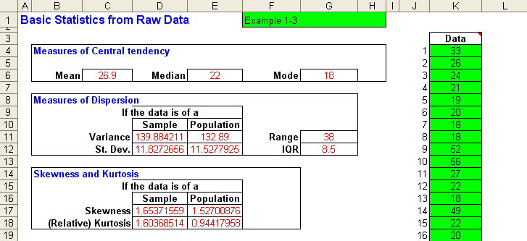
Example 1-3: Using the Template
1-<number>

Slide 23
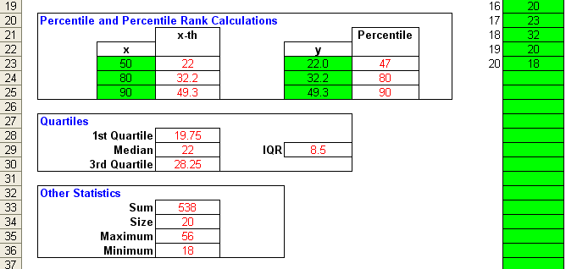
Example 1-3 (Continued): Using the Template
1-<number>
This is the lower part of the same template from the previous slide.

Slide 24
Summary Measures: Population Parameters Sample Statistics
1-<number>
Measures of Central Tendency
  Median
  Mode
  Mean
Measures of Variability
  Range
  Interquartile range
  Variance
  Standard Deviation
Other summary measures:
  Skewness
  Kurtosis

Slide 25
1-3 Measures of Central Tendency or Location
1-<number>
•
Median
Middle value when
sorted in order of
magnitude
50th percentile
•
Mode
Most frequently-
occurring value
•
Mean
Average

Slide 26
Example – Median (Data is used from Example 1-2)
1-<number>
Sorted
Billions Billions
33 18
26 18
24 18
21 18
19 19
20 20
18 20
18 20
52 21
56 22
27 22
22 23
18 24
49 26
22 27
20 32
23 33
32 49
20 52
18 56
Median
50th Percentile
(20+1)50/100=10.5
22 + (.5)(0) = 22
Median
The median is the middle value of data sorted in order of magnitude. It is the 50th percentile.

Slide 27
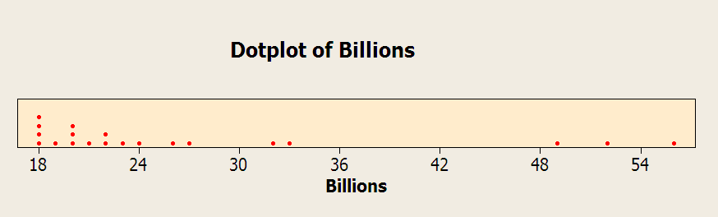
Example - Mode (Data is used from Example 1-2)
1-<number>
Mode = 18
The mode is the most frequently occurring value. It is the value with the highest frequency.

Slide 28
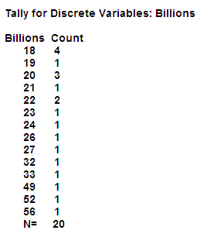
Example - Mode (Data is used from Example 1-2)
1-<number>
Mode = 18
The mode is the most frequently occurring value. It is the value with the highest frequency.

Slide 29
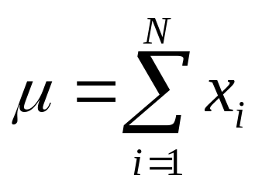
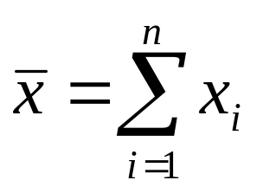
Arithmetic Mean or Average
1-<number>
The mean of a set of observations is their average - the sum of the observed values divided by the number of observations.
Population Mean
Sample Mean

Slide 30
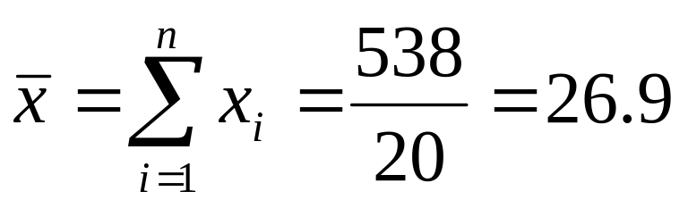
Example – Mean (Data is used from Example 1-2)
1-<number>
Sorted
Billions Billions
33 18
26 18
24 18
21 18
19 19
20 20
18 20
18 20
52 21
56 22
27 22
22 23
18 24
49 26
22 27
20 32
23 33
32 49
20 52
18 56
Sum = 538

Slide 31
1-4 Measures of Variability or Dispersion
1-<number>
Range
  Difference between maximum and minimum values
Interquartile Range
  Difference between third and first quartile (Q₃ - Q₁)
Variance
  Average*of the squared deviations from the mean
Standard Deviation
  Square root of the variance
∗ Definitions of population variance and sample variance differ slightly.

Slide 32
Example 1-3: Finding Quartiles
1-<number>
Sorted
Billions Billions Ranks
33 18 1
26 18 2
24 18 3
21 18 4
19 19 5
20 20 6
18 20 7
18 20 8
52 21 9
56 22 10
27 22 11
22 23 12
18 24 13
49 26 14
22 27 15
20 32 16
23 33 17
32 49 18
20 52 19
18 56 20
Range = Maximum – Minimum
= 56 – 18 = 38
First Quartile
(20+1)×25/100=5.25
19 + (.25)(1) = 19.25
Median
(20+1)×50/100=10.5
22 + (.5)(0) = 22
Third Quartile
(20+1)×75/100=15.75
27+ (.75)(5) = 30.75
Interquartile Range = Q3 – Q1
= 30.75 – 19.25 = 11.5

Slide 33
Variance and Standard Deviation
1-<number>
Population Variance
Sample Variance
n
−
N
∑
(
x
x
)
2
∑
(
x
−
μ
)
2
s
2
=
i
=
1
σ
2
=
i
=
1
(
n
−
1
)
N
(
)
(
)
N
2
n
2
∑
x
∑
x
N
=
n
−
i
=
1
∑
x
2
−
i
1
∑
x
2
N
=
=
n
=
i
=
1
i
1
N
(
n
−
1
)
σ
=
σ
2
s
=
s
2

Slide 34


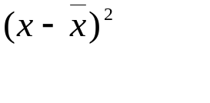
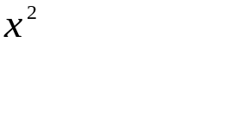
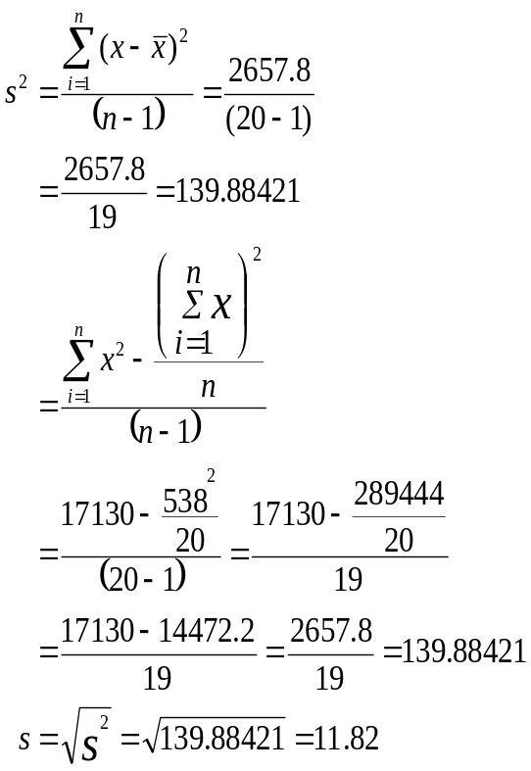
Calculation of Sample Variance
1-<number>
18 -8.9 79.21 324
18 -8.9 79.21 324
18 -8.9 79.21 324
18 -8.9 79.21 324
19 -7.9 62.41 361
20 -6.9 47.61 400
20 -6.9 47.61 400
20 -6.9 47.61 400
21 -5.9 34.81 441
22 -4.9 24.01 484
22 -4.9 24.01 484
23 -3.9 15.21 529
24 -2.9 8.41 576
26 -0.9 0.81 676
27 0.1 0.01 729
32 5.1 26.01 1024
33 6.1 37.21 1089
49 22.1 488.41 2401
52 25.1 630.01 2704
56 29.1 846.81 3136
538 0 2657.8 17130

Slide 35
Example: Sample Variance Using the Template
1-<number>
Sample Variance

Slide 36
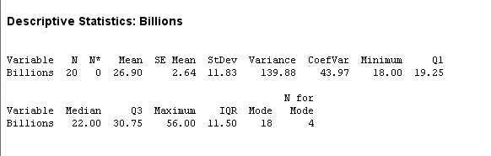
Example: Sample Variance Using Minitab
1-<number>
Sample Variance

Slide 37
1-5 Group Data and the Histogram
1-<number>
Dividing data into groups or classes or intervals
Groups should be:
  Mutually exclusive
    Not overlapping - every observation is assigned to only one group
  Exhaustive
    Every observation is assigned to a group
  Equal-width (if possible)
    First or last group may be open-ended

Slide 38
Frequency Distribution
1-<number>
Table with two columns listing:
  Each and every group or class or interval of values
  Associated frequency of each group
    Number of observations assigned to each group
    Sum of frequencies is number of observations
      N for population
      n for sample
Class midpoint is the middle value of a group or class or interval
Relative frequency is the percentage of total observations in each class
  Sum of relative frequencies = 1

Slide 39
Example 1-7: Frequency Distribution
1-<number>
x f(x) f(x)/n
Spending Class ($) Frequency (number of customers) Relative Frequency
0 to less than 100 30 0.163
100 to less than 200 38 0.207
200 to less than 300 50 0.272
300 to less than 400 31 0.168
400 to less than 500 22 0.120
500 to less than 600 13 0.070
184 1.000
Example of relative frequency: 30/184 = 0.163
Sum of relative frequencies = 1

Slide 40
Cumulative Frequency Distribution
1-<number>
x F(x) F(x)/n
Spending Class ($) Cumulative Frequency Cumulative Relative Frequency
0 to less than 100 30 0.163
100 to less than 200 68 0.370
200 to less than 300 118 0.641
300 to less than 400 149 0.810
400 to less than 500 171 0.929
500 to less than 600 184 1.000
The cumulative frequency of each group is the sum of the
frequencies of that and all preceding groups.

Slide 41
Histogram
1-<number>
A histogram is a chart made of bars of different heights.
  Widths and locations of bars correspond to widths and locations of data groupings
  Heights of bars correspond to frequencies or relative frequencies of data groupings

Slide 42
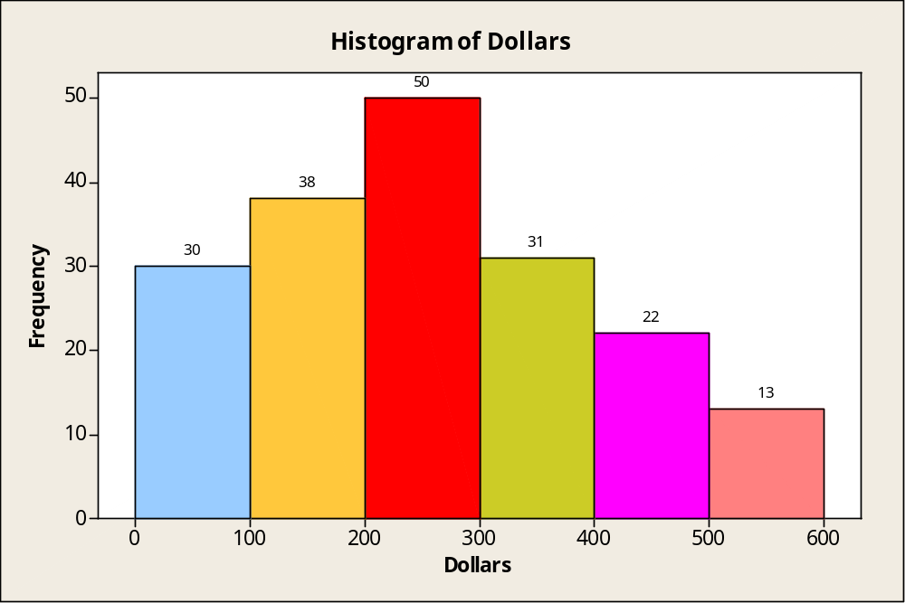
Histogram for Example 1-7
1-<number>
Frequency Histogram

Slide 43
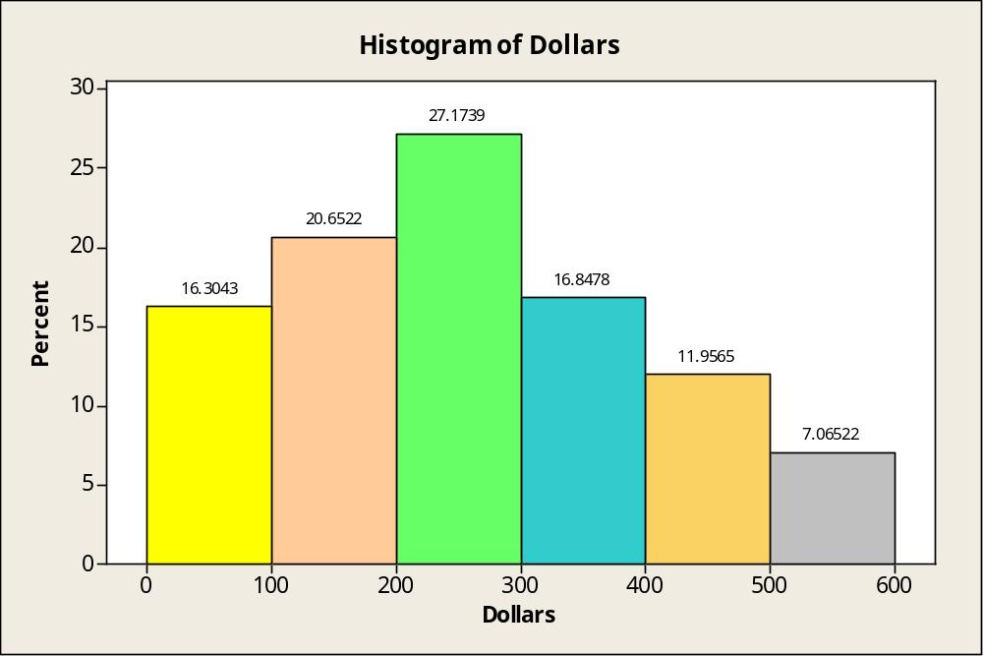
Relative Frequency Histogram Example 1-7
1-<number>
Relative Frequency Histogram
NOTE: The relative
frequencies
are expressed
as percentages.

Slide 44
1-6 Skewness and Kurtosis
1-<number>
Skewness
  Measure of the degree of asymmetry of a frequency distribution
    Skewed to left
    Symmetric or unskewed
    Skewed to right
Kurtosis
  Measure of flatness or peakedness of a frequency distribution
    Platykurtic (relatively flat)
    Mesokurtic (normal)
    Leptokurtic (relatively peaked)

Slide 45
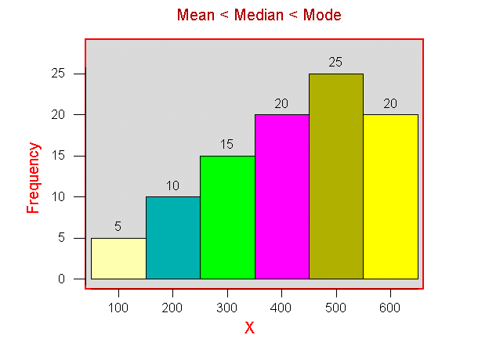
Skewness
1-<number>
Skewed to left

Slide 46
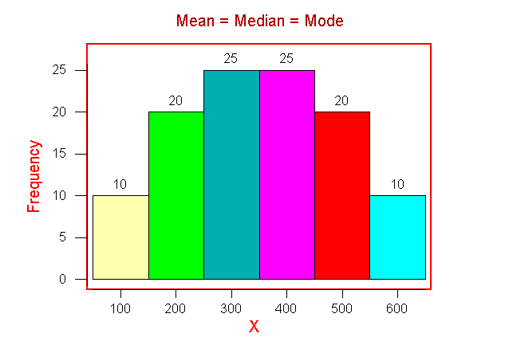
Skewness
1-<number>
Symmetric

Slide 47
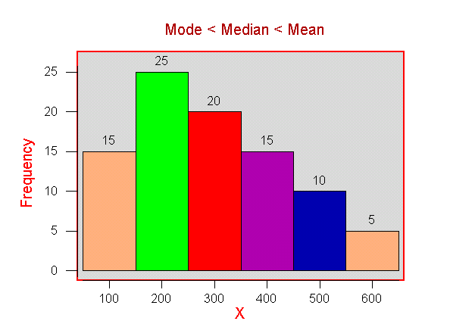
Skewness
1-<number>
Skewed to right

Slide 48
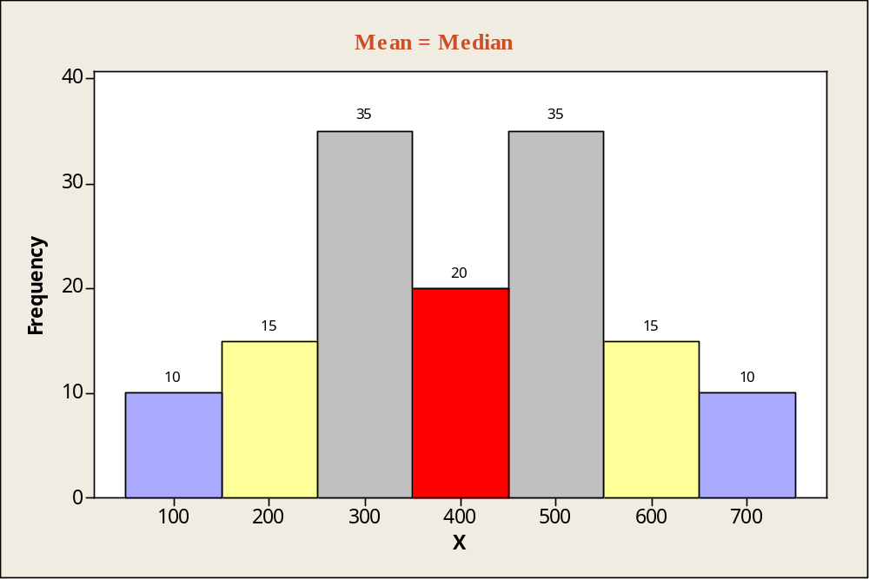
Symmetric Bimodal Distribution
1-<number>
Symmetric distribution with two Modes

Slide 49
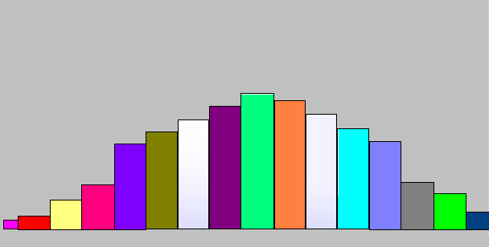
Kurtosis
1-<number>
Platykurtic - flat distribution

Slide 50
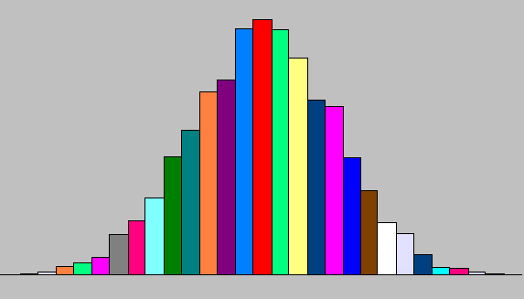
Kurtosis
1-<number>
Mesokurtic - not too flat and not too peaked

Slide 51
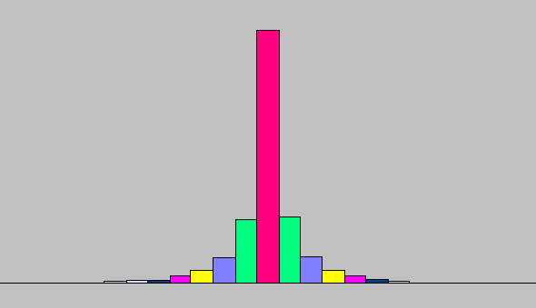
Kurtosis
1-<number>
Leptokurtic - peaked distribution

Slide 52
1-7 Relations between the Mean and Standard Deviation
1-<number>
Chebyshev’s Theorem
  Applies to any distribution, regardless of shape
  Places lower limits on the percentages of observations within a given number of standard deviations from the mean
Empirical Rule
  Applies only to roughly mound-shaped and symmetric distributions
  Specifies approximate percentages of observations within a given number of standard deviations from the mean

Slide 53
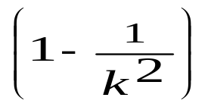
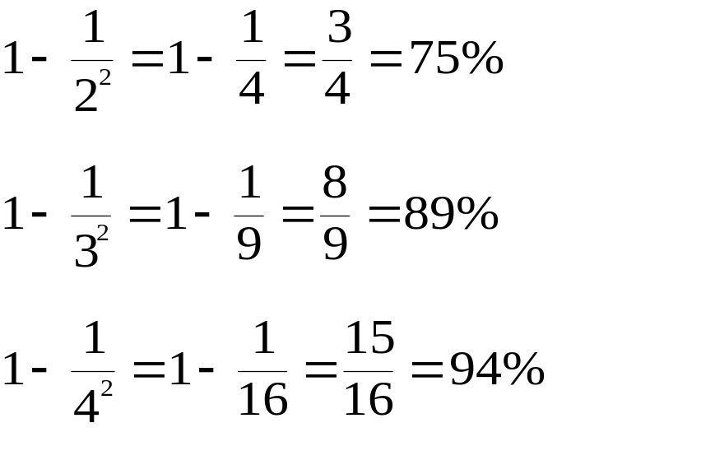
Chebyshev’s Theorem
1-<number>
At least of the elements of any distribution lie within k standard deviations of the mean
2
3
4
Standard
deviations
of the mean
At
least
Lie
within

Slide 54
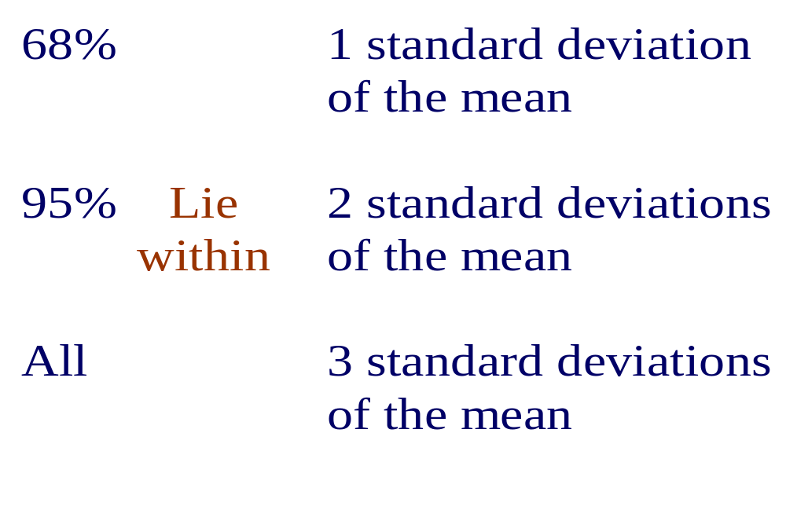
Empirical Rule
1-<number>
For roughly mound-shaped and symmetric distributions, approximately:

Slide 55
1-8 Methods of Displaying Data
1-<number>
Pie Charts
  Categories represented as percentages of total
Bar Graphs
  Heights of rectangles represent group frequencies
Frequency Polygons
  Height of line represents frequency
Ogives
  Height of line represents cumulative frequency
Time Plots
  Represents values over time

Slide 56
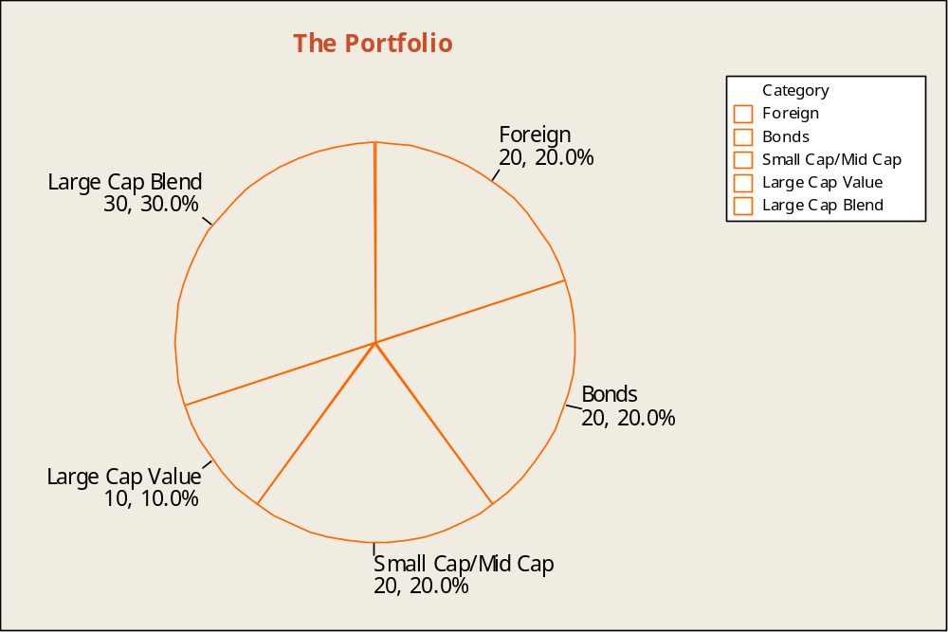
Pie Chart (Figure 1-8) – Investment Portfolio
1-<number>

Slide 57
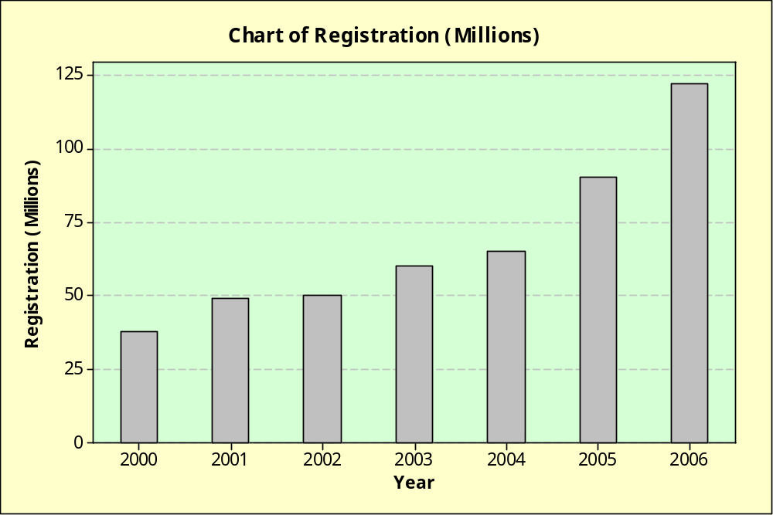
Bar Chart (Figure 1-9) – The Web Takes Off
1-<number>

Slide 58
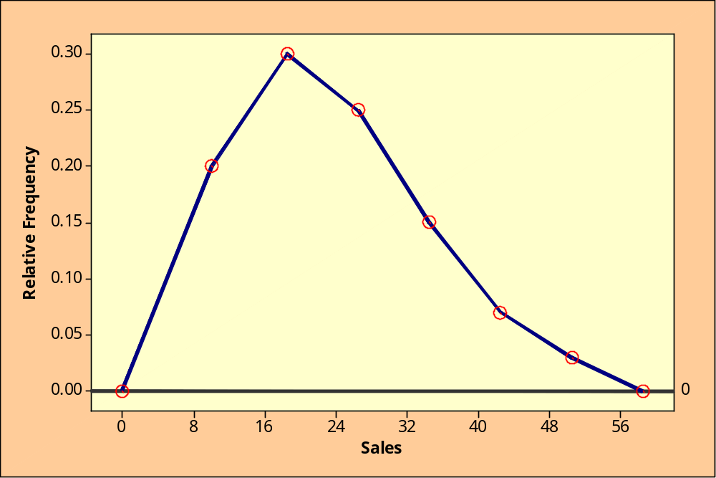
Relative Frequency Polygon (Figure 1-10)
1-<number>
Frequency is
Located in the
middle of the
interval.

Slide 59
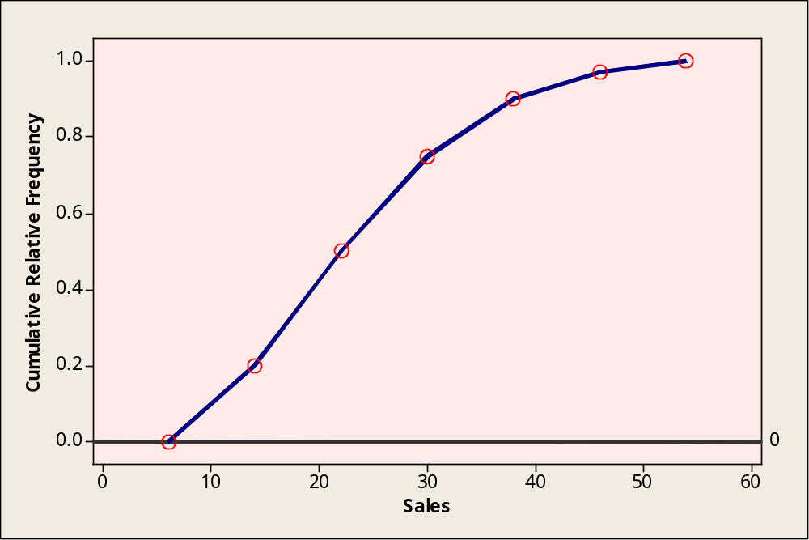
Ogive (Figure 1-12)
1-<number>
The point with height
corresponding to
the cumulative
relative frequency is
located at the right
endpoint of each
interval.

Slide 60
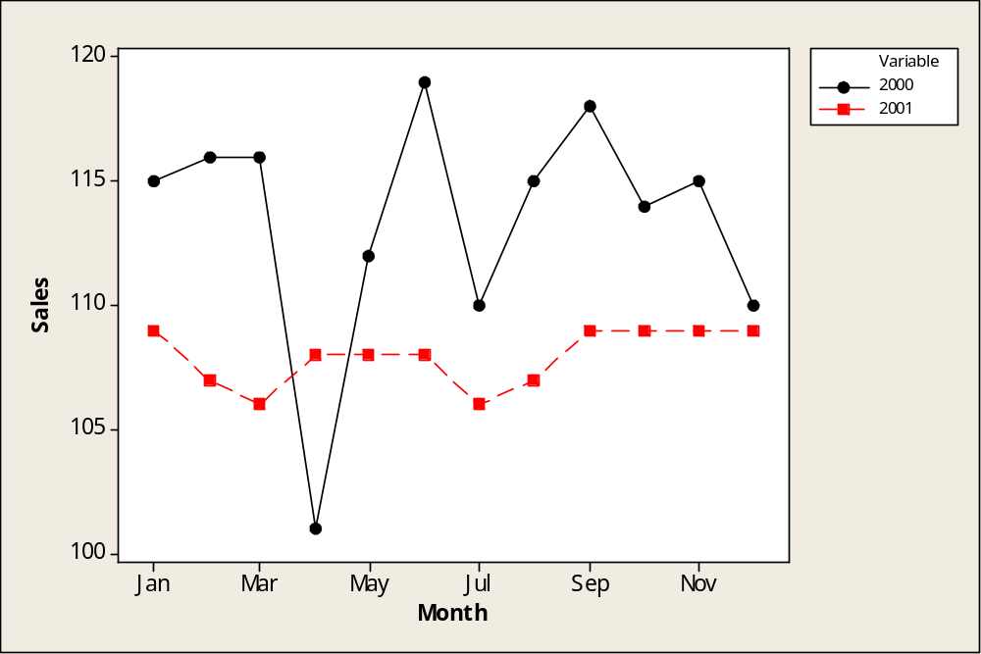
Time Plot (Figure 1-24) – Sales Comparison
1-<number>

Slide 61
1-9 Exploratory Data Analysis - EDA
1-<number>
Techniques to determine relationships and trends, identify outliers and influential observations, and quickly describe or summarize data sets.
Stem-and-Leaf Displays
  Quick way of listing all observations
  Conveys some of the same information as a histogram
Box Plots
  Median
  Lower and upper quartiles
  Maximum and minimum

Slide 62
Example 1-8: Stem-and-Leaf Display
1-<number>
1 1 2 2 3 5 5 5 6 7
2 0 1 1 1 2 2 2 3 4 6 7 7 7 8 9 9
3 0 1 2 4 5 7
4 1 1 2 5 7
5 0 2 3 6
6 0 2
Figure 1-15: Task Performance Times

Slide 63
Box Plot
1-<number>
Elements of a Box Plot
Smallest data point not below inner fence
Largest data point not exceeding inner fence
Suspected outlier
Outlier
o
*
X
X
Inner
Fence
Q1
Median
Q3
Outer
Fence
Inner
Fence
Outer
Fence
Q1-1.5(IQR)
Interquartile Range
Q3+1.5(IQR)
Q1-3(IQR)
Q3+3(IQR)

Slide 64
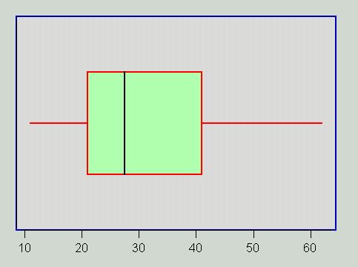
Example: Box Plot
1-<number>

Slide 65
Example 1-3: Using the Template to compute Descriptive Statistics
1-<number>

Slide 66
Example 1-3 (Continued): Using the Template to compute Descriptive Statistics
1-<number>
This is the lower part of the same template from the previous slide.

Slide 67
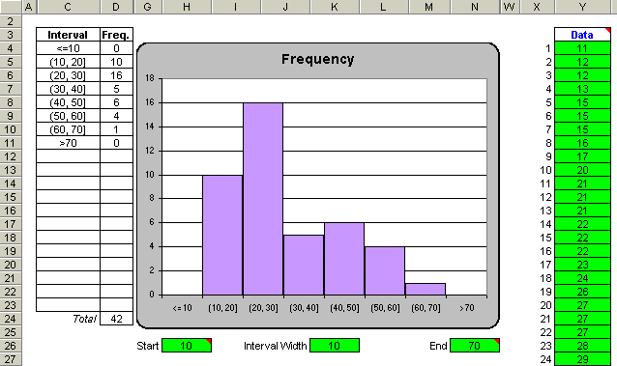
Using the Computer – Template Output for the Histogram
1-<number>

Slide 68
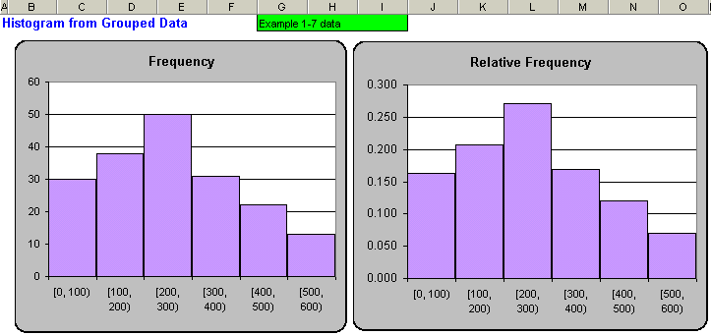
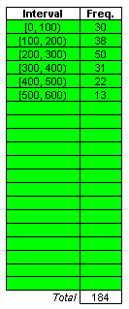
Using the Computer – Template Output for Histograms for Grouped Data
1-<number>

Slide 69
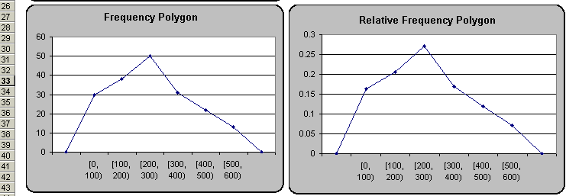
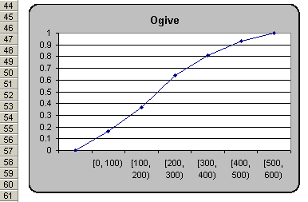
Using the Computer – Template Output for Frequency Polygons & the Ogive for Grouped Data
1-<number>

Slide 70
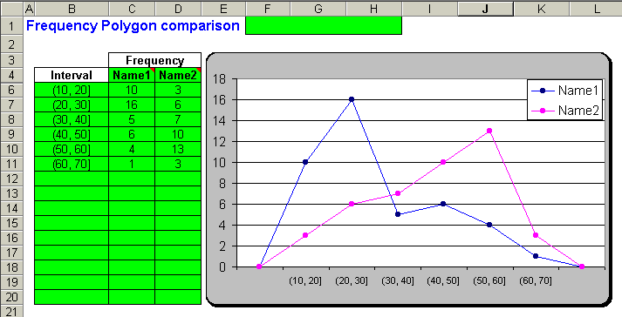
Using the Computer – Template Output for Two Frequency Polygons for Grouped Data
1-<number>

Slide 71
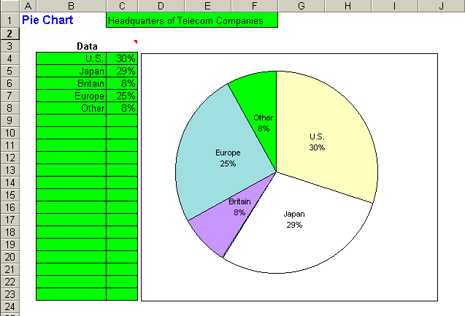
Using the Computer – Pie Chart Template Output
1-<number>

Slide 72
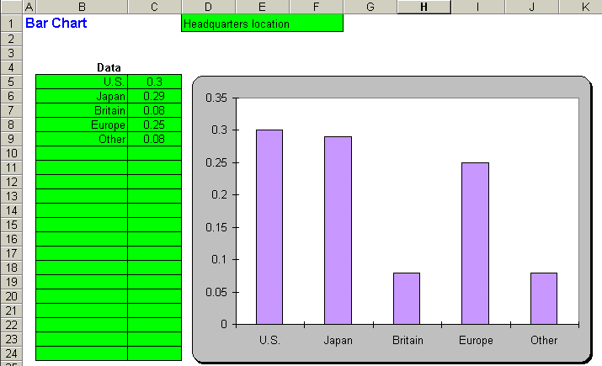
Using the Computer – Bar Chart Template Output
1-<number>

Slide 73
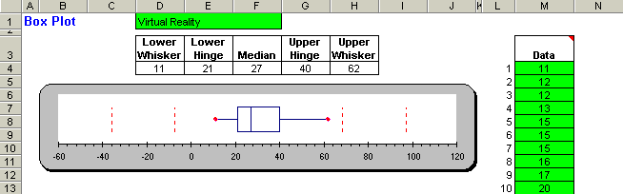
Using the Computer – Box Plot Template Output
1-<number>

Slide 74
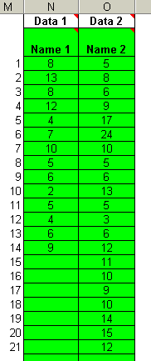
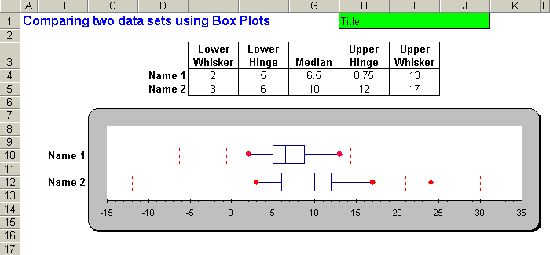
Using the Computer – Box Plot Template to Compare Two Data Sets
1-<number>

Slide 75
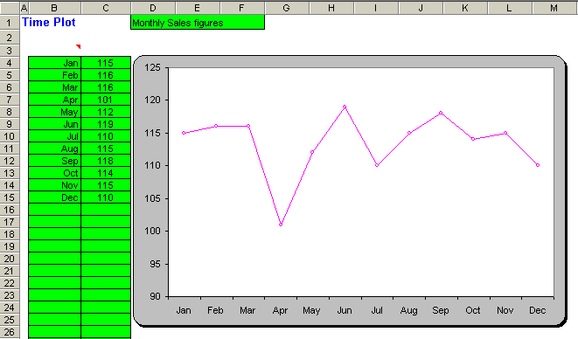
Using the Computer – Time Plot Template
1-<number>

Slide 76
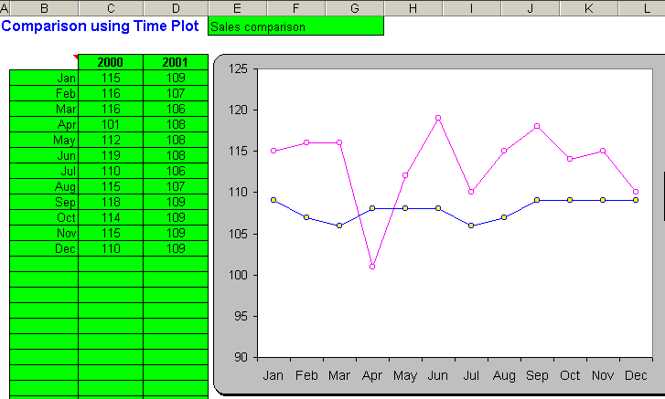

Using the Computer – Time Plot Comparison Template
1-<number>

Slide 77
Scatter Plots
1-<number>
Scatter Plots are used to identify and report any underlying relationships among pairs of data sets.
The plot consists of a scatter of points, each point representing an observation.

Slide 78
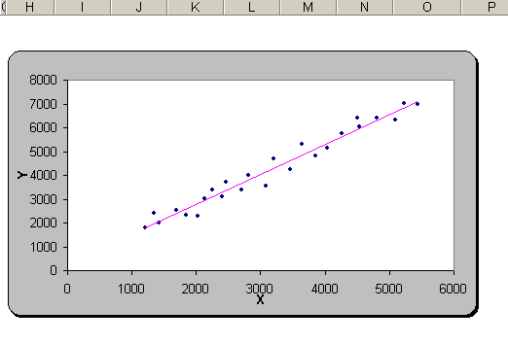
Scatter Plots
1-<number>
Scatter plot with
trend line.
This type of
relationship is
known
as a positive
correlation.
Correlation will be
discussed in later
chapters.

Slide 79
NOTE
1-<number>
MANY OF THE GRAPHS
PRESENTED IN THIS CHAPTER
CAN BE
GENERATED WITH
MINITAB AS WELL.

